Slide 1
13/11/-17/11/17 8th week

Slide 2
Multilevel Self-organised Collaborative Optimization (MSCO)
Here the basic idea is, the direction interaction should only appear in local groups, or local neighbours. Here the local neighbours are defined not by Euclidean distance, but dependence distance.
Then the global optimization problem becomes self group making, and a final unitary group means the global optimum.
The optimization process could be regarded as the emergence of a unitary group which concludes all participates’ benefit and leads to a compromise.
The idea is inspired from the emergence of the primary city-state.
4
4
4
System
4
2
3
3
2
5
1
3

Slide 3
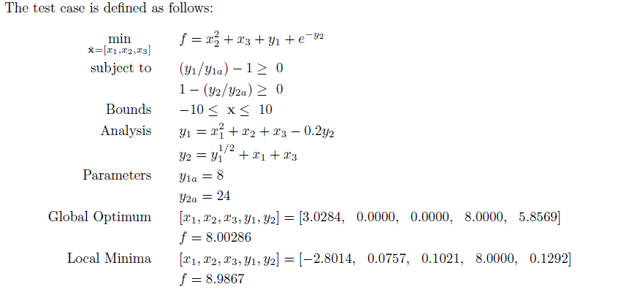
Test case

Slide 4
MSCO for two disciplines
System
v
v
v
v
Sub A
Sub B
v
v
The key idea in MSCO is to make a new information channel between two subspaces for the transmission of state variables, so that the subspace can do the optimization problem as much independent as possible with a fuzzy help of the other subspace.

Slide 5
General frame
z
Sub 1
Sub 2
Sub 3

Slide 6
System-subspace description
System optimizer
Sub 1
Sub 2
Sub 3
Sub 4
Analysis 1
Analysis 2
Analysis 3
Analysis 4

Slide 7
MSCO
S
No constraints
Input:
Output:
1
Analysis
Input:
Output:
2
Analysis
Input:
Output:

Slide 8
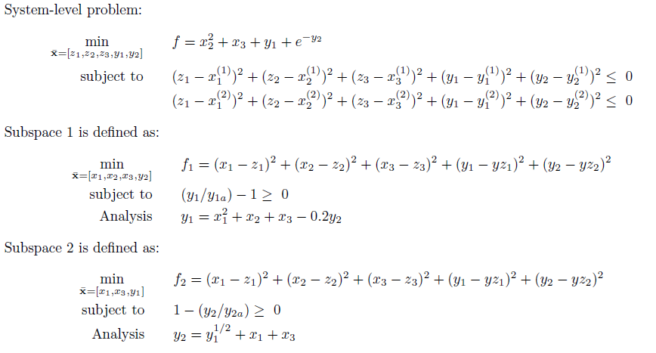
CO

Slide 9
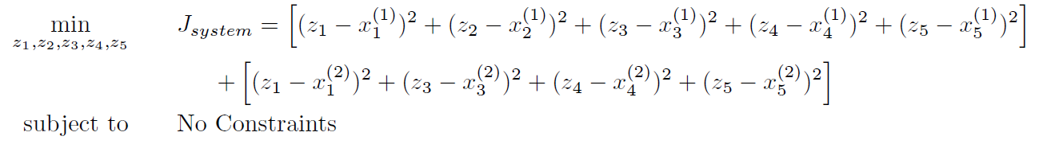
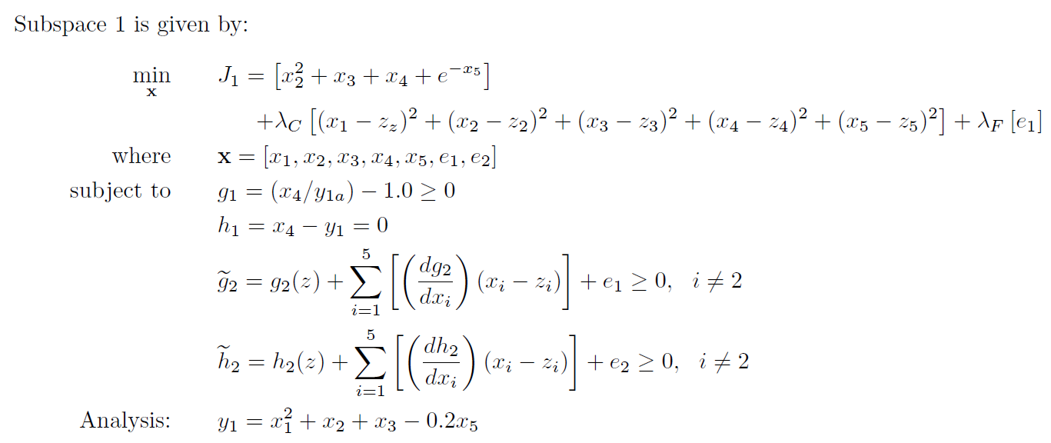
ECO

Slide 10
Comparison of main features
CO
All subspaces do not know the global objective, also do not need to communicate with or has prior information of all other subspaces. All they need to do is to try their best to satisfy the needs of system level.
The system level has global horizon, it checks the results obtained by subspaces and hand out new demands.
ECO
All subspaces know the global objective and solve the optimization problem independently with the prior information of all other subspaces’ constraints and analysis.
The system level do nothing but the average of all variables (design variables and state variables).
MSCO
All subspaces know the global objective and solve the optimization problem with the changing state variables provided by its neighbours at each iteration.
The system level do nothing but the average of design variables.

Slide 11
Results
MSCO Global best 3.0326 0.0431 0.0000 8.0000 5.8783
No influence by start points and quick convergence.

Slide 12
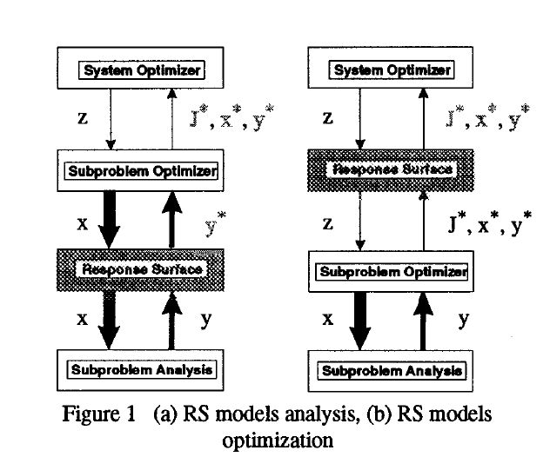
Response Surface method
Response surfaces are typically used to model disciplining analyses. The aim of this process is to simplify the substantial analyses involved in sub-problem optimization processes and the potential numerical difficulties for the standard CO are avoided. However, structuring a high-precision surrogate module requires a large number of sample data pairs, which reduces subsystem-level computational efficiency to a certain degree.

